Slide 1
Evaluating HPC Scheduling Strategies for Urgent Workloads
Nov 21, 2025, WIUHPC at SC25
Ketan Maheshwari, Anderson Borch (Colorado State Univ), Jordan Webb, Brian Etz, Ross Miller, Frederic Suter, Sarp Oral, Rafael Ferreira da Silva
Oak Ridge National Laboratory

Slide 2
Overview
A study and analysis of responsiveness, (un)fairness, user-experience and system utilization in an HPC job scheduling environment where a fraction of jobs have requirements for urgent computing.
Results quantify user and system performance outcomes, reusable code artefacts and generalized visualization methods from standard Slurmdb data.
Code and other artefacts at: github.com/ketancmaheshwari/wiuhpc25

Slide 3
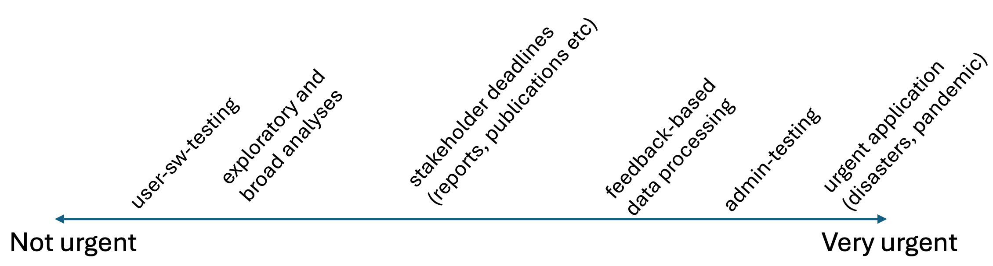
Context
DOE IRI vision to accommodate applications with diverse urgency requirements within a unified environment.
An attempt to analyze scenarios where a fraction of jobs must be allocated urgently.

Slide 4
Contributions
A comparative evaluation of four representative job scheduling simulators
Design and implementation of an emulation-based methodology that operates on a real cluster
Visual analytics, including per-user timelines, scheduling and cluster utilization trends
A recommended mapping between workload profiles and recommended scheduler configs
Notes:
identifying their capabilities and critical limitations for modeling urgent and mixed-urgency HPC workloads.
enabling reproducible experiments with realistic user submission patterns, urgency levels, and QoS policies.
requeueing options, and workload characteristics, allowing detailed analysis of trade-offs between responsiveness, fairness, and efficiency.
and backfilling behavior, to provide actionable insights into how scheduler policies affect both urgent and normal workloads.
resulting in a practical hybrid scheduling strategy that HPC centers can adapt to balance urgent computing needs with sustained system utilization.

Slide 5
Evaluation of Job Scheduling Simulators
We begin with looking into the existing job scheduling simulators
Selected 4 representative simulators: Batsim, Accasim, Alea and The Slurm Scheduler
P-F Dutot, M Mercier et al 2016. Batsim: a Realistic Language-Independent Resources and Jobs Management Systems Simulator. doi:10.1007/978-3-319-61756-5_10
C Galleguillos, Z Kiziltan et al 2020. AccaSim: A Customizable Workload Management Simulator for Job Dispatching Research in HPC Systems. doi:10.1007/s10586-019-02905-5
D Klusacek, M Soysal, and F Suter. 2019. Alea - Complex Job Scheduling Simulator. doi:10.1007/978-3-030-432225_19
N A Simakov, R L DeLeon et al 2018. Slurm Simulator: Improving Slurm Scheduler Performance on Large HPC systems by Utilization of Multiple Controllers and Node Sharing. doi:10.1145/3219104.3219111

Slide 6
Job Scheduling Simulators: Batsim and Accasim
Batsim is a C++ based job simulator
Supports the Standard Workload Format (SWF) and JSON data
Includes built-in tools to generate workloads and define simulated platforms
We ran Batsim with a custom workload that parameterizes number of jobs, submission intervals, wall-time ranges and failure rates.
However, we could not induce urgency QoS levels, priority boosts and preemption mechanisms.
Accasim is Python based
Supports only SWF data
Offers limited built-in scheduling algorithms compared to Batsim
We were able to run Accasim using Batsim generared loads.
Faced some difficulties in interpreting results due to limited labeling of outputs.
No native support for QoS levels or preemption mechanisms.
[See our paper for feature comparison in more details]

Slide 7
Job Scheduling Simulators: Alea and the Slurm scheduler
Alea: Java-based, provides a few scheduling algorithms and user-defined scheduling policy; a form of QoS is supported via multiple queues however preemption is not supported.
Alea turned out to be close to our requirements -- we engaged with its main developer and are in the process of adding features resulting in a next gen version ”AleaNG”.
The Slurm scheduler: Aims to reproduce actual Slurm scheduling behavior in a controlled environment mimicking real environment as close as possible.
Designed to run inside a Docker container. Posed challenges in deployment in lab managed environments. Current release runs an older Slurm (v20.11) compared to OLCF systems (v25.05)
Notes:
A Next Gen Alea is under active development

Slide 8
Feature gaps in simulators wrt our requirements
No or limited native support for urgent QoS or urgency aware scheduling
Limited or no implementation of job preemption with realistic handling of cancellation or requeuing of preempted jobs
Limited modeling of dynamic user behavior (cancellations, timeouts) and event-driven job arrivals
Practical deployment barriers in our testbed environment
Nevertheless, job scheduling simulators are very valuable tools
Notes:
Even with extensive customization, these tools could not fully reproduce the operational conditions of a real HPC scheduler under urgent computing demands. This assessment led us to adopt an emulation-based methodology

Slide 9
A Rare Opportunity: The OLCF Advanced Compute Ecosystem (ACE) Testbed
A promise of “Emulating” Job Scheduling over a real Cluster
20 Intel nodes with 64 CPUs (2 logical cores/CPU) and 8 Nvidia H200 GPU nodes
Slurm version 25.05
20 dummy user accounts were created: common group memberships and privileges

Slide 10
Instrumentation: Experimental Setup
run in sync mode
for 20 dummy users
invoke MPICatnap* with a
controlled runtime
Tmux session with 22 panes
genjobs script
slurm job
spec
MPIcatnap*
2 sessions
Generate job spec with randomized
and controlled parameters;
submit at random intervals
control and monitor
* code courtesy: MJ Wilde, ANL/UChicago

Slide 11
Features of the Experiment setup
Generate and submit jobs at randomized intervals
Randomized job parameters within defined limits
walltimes, node size,
Urgent jobs marked via “urgent” QoS in Slurm
Customizable application runtimes
wrt to the job walltimes
The mock mpicatnap application:
cats an input file to an output file (minimal I/O)
runs sleep process for defined time on all cpu cores
Monitoring enabled but may run unsupervised in detached tmux sessions
Notes:
So mpicatnap does not consume any resources
In summary: we were able to pack significant amount of features in a relatively tiny setup

Slide 12
Experiments Design: Nine experiments with varying conditions
E1, E2 and E4: Calibrations on short and long, fixed and varying number of jobs, timeouts, backfill verifications
E3: 20 jobs/user, 5-10% urgent jobs, preempt and cancel
E5: Same as E3, except no preemption and priority boost for urgent QoS jobs
E6: Same as E3 except preempt and requeue
E7: Short 10-min app runtime that is 10-20% of job walltimes, preempt and requeue
E8: Same as E7 except preempt and cancel
E9: Same as E7 except app runtime is 80-90% of walltimes, preempt and cancel

Slide 13
Visual overview of all experiment runs
Plots show jobs’ end state vs wait time in queue for each job across all experiments
Note the differences in the Y-axes values that indicate the disparities in the wait times resulting from each experiment setup

Slide 14
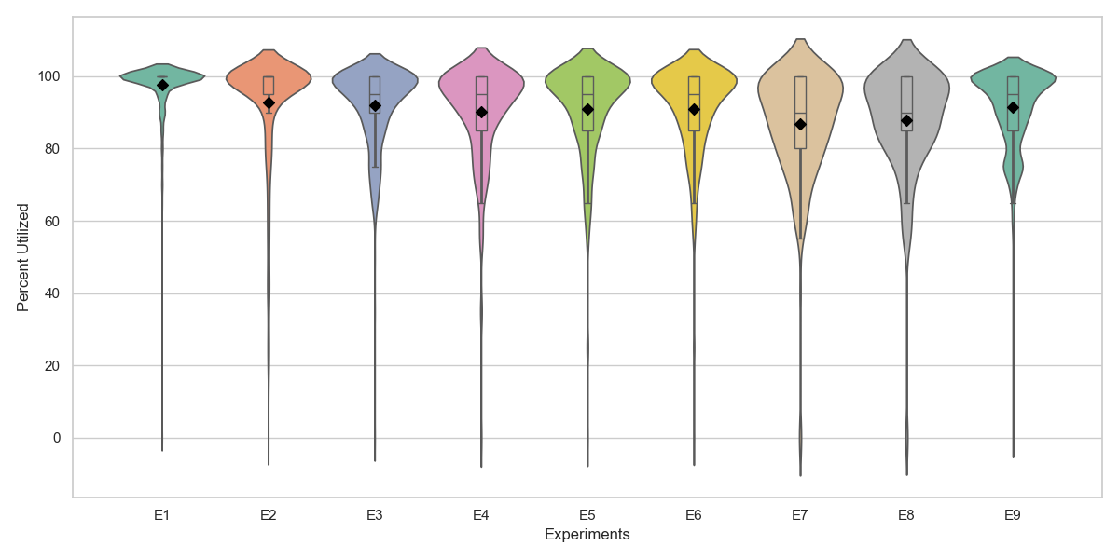
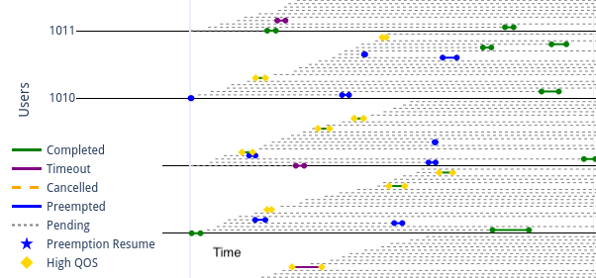
Results Visualization: User view of jobs and cluster utilization
. . .
“Swimlanes” for user job states and events
Gives a vizualization of simultaneous events for users
Cluster utilization via sinfo (probed once per min)
violin width = distribution at that percent utilization Diamond = mean, box = median and quartile

Slide 15
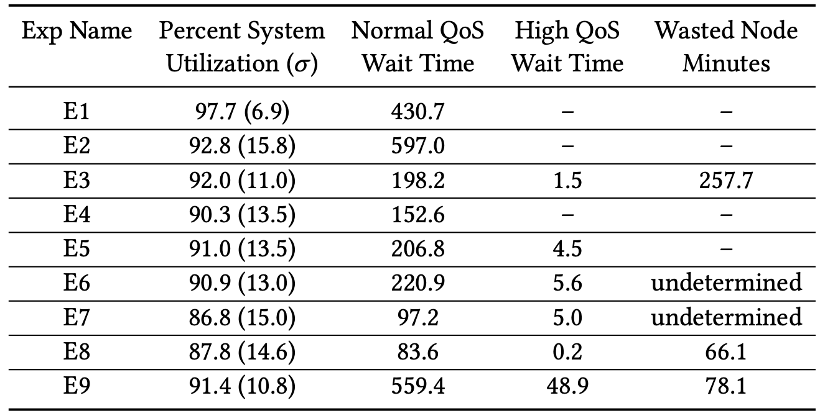
Statistical analysis for various outcomes on each of the experiments
Tradeoffs between system utilization and user outcomes (both normal and urgent) under various Experimental conditions!
Wasted node minutes ”undetermined” for cases where jobs are preempted and requeued since Slurm do not keep a record of preemption time
No single ”ideal” setup

Slide 16
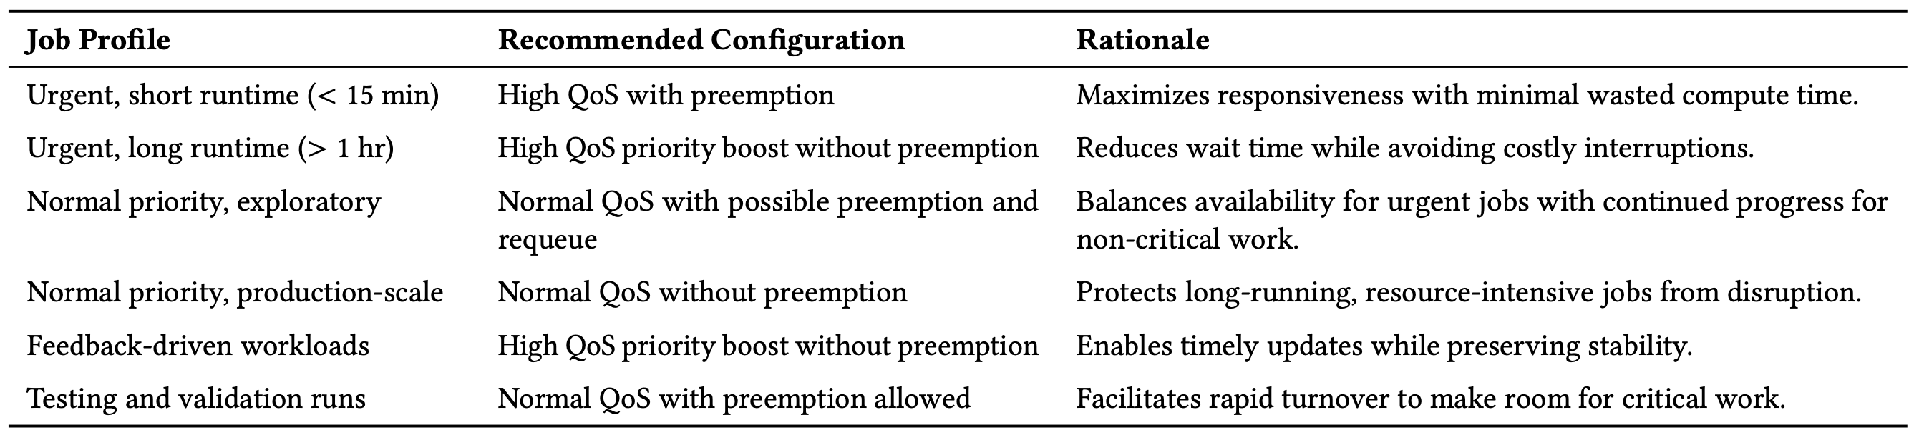
Experiments Conclusion: Recommendations for HPC Scheduling environments based on Outcomes

Slide 17
Conclusion and Future Work
An emulator for job scheduling emulating tunable, real-world job scenarios
A reproducible, reusable set of configurations, code artefacts, and results viz routines
Identifying kinds of job on an urgency-continuum is a challenge
Featureful simulators are still valuable
Future: Alea -> AleaNG addressing the limitations of simulators and enabling many more experimental scenarios rapidly
Notes:
Look into job patterns of a real system and model it. Long term pattern simulations .. months and years.

Slide 18
Acknowledgements
This research used resources of the OLCF at ORNL, which is supported by DOE’s Office of Science under Contract No. DE-AC05-00OR22725.

Slide 19
Thank You for your time! Questions?
km0@ornl.gov | https://github.com/ketancmaheshwari/wiuhpc25

Slide 20
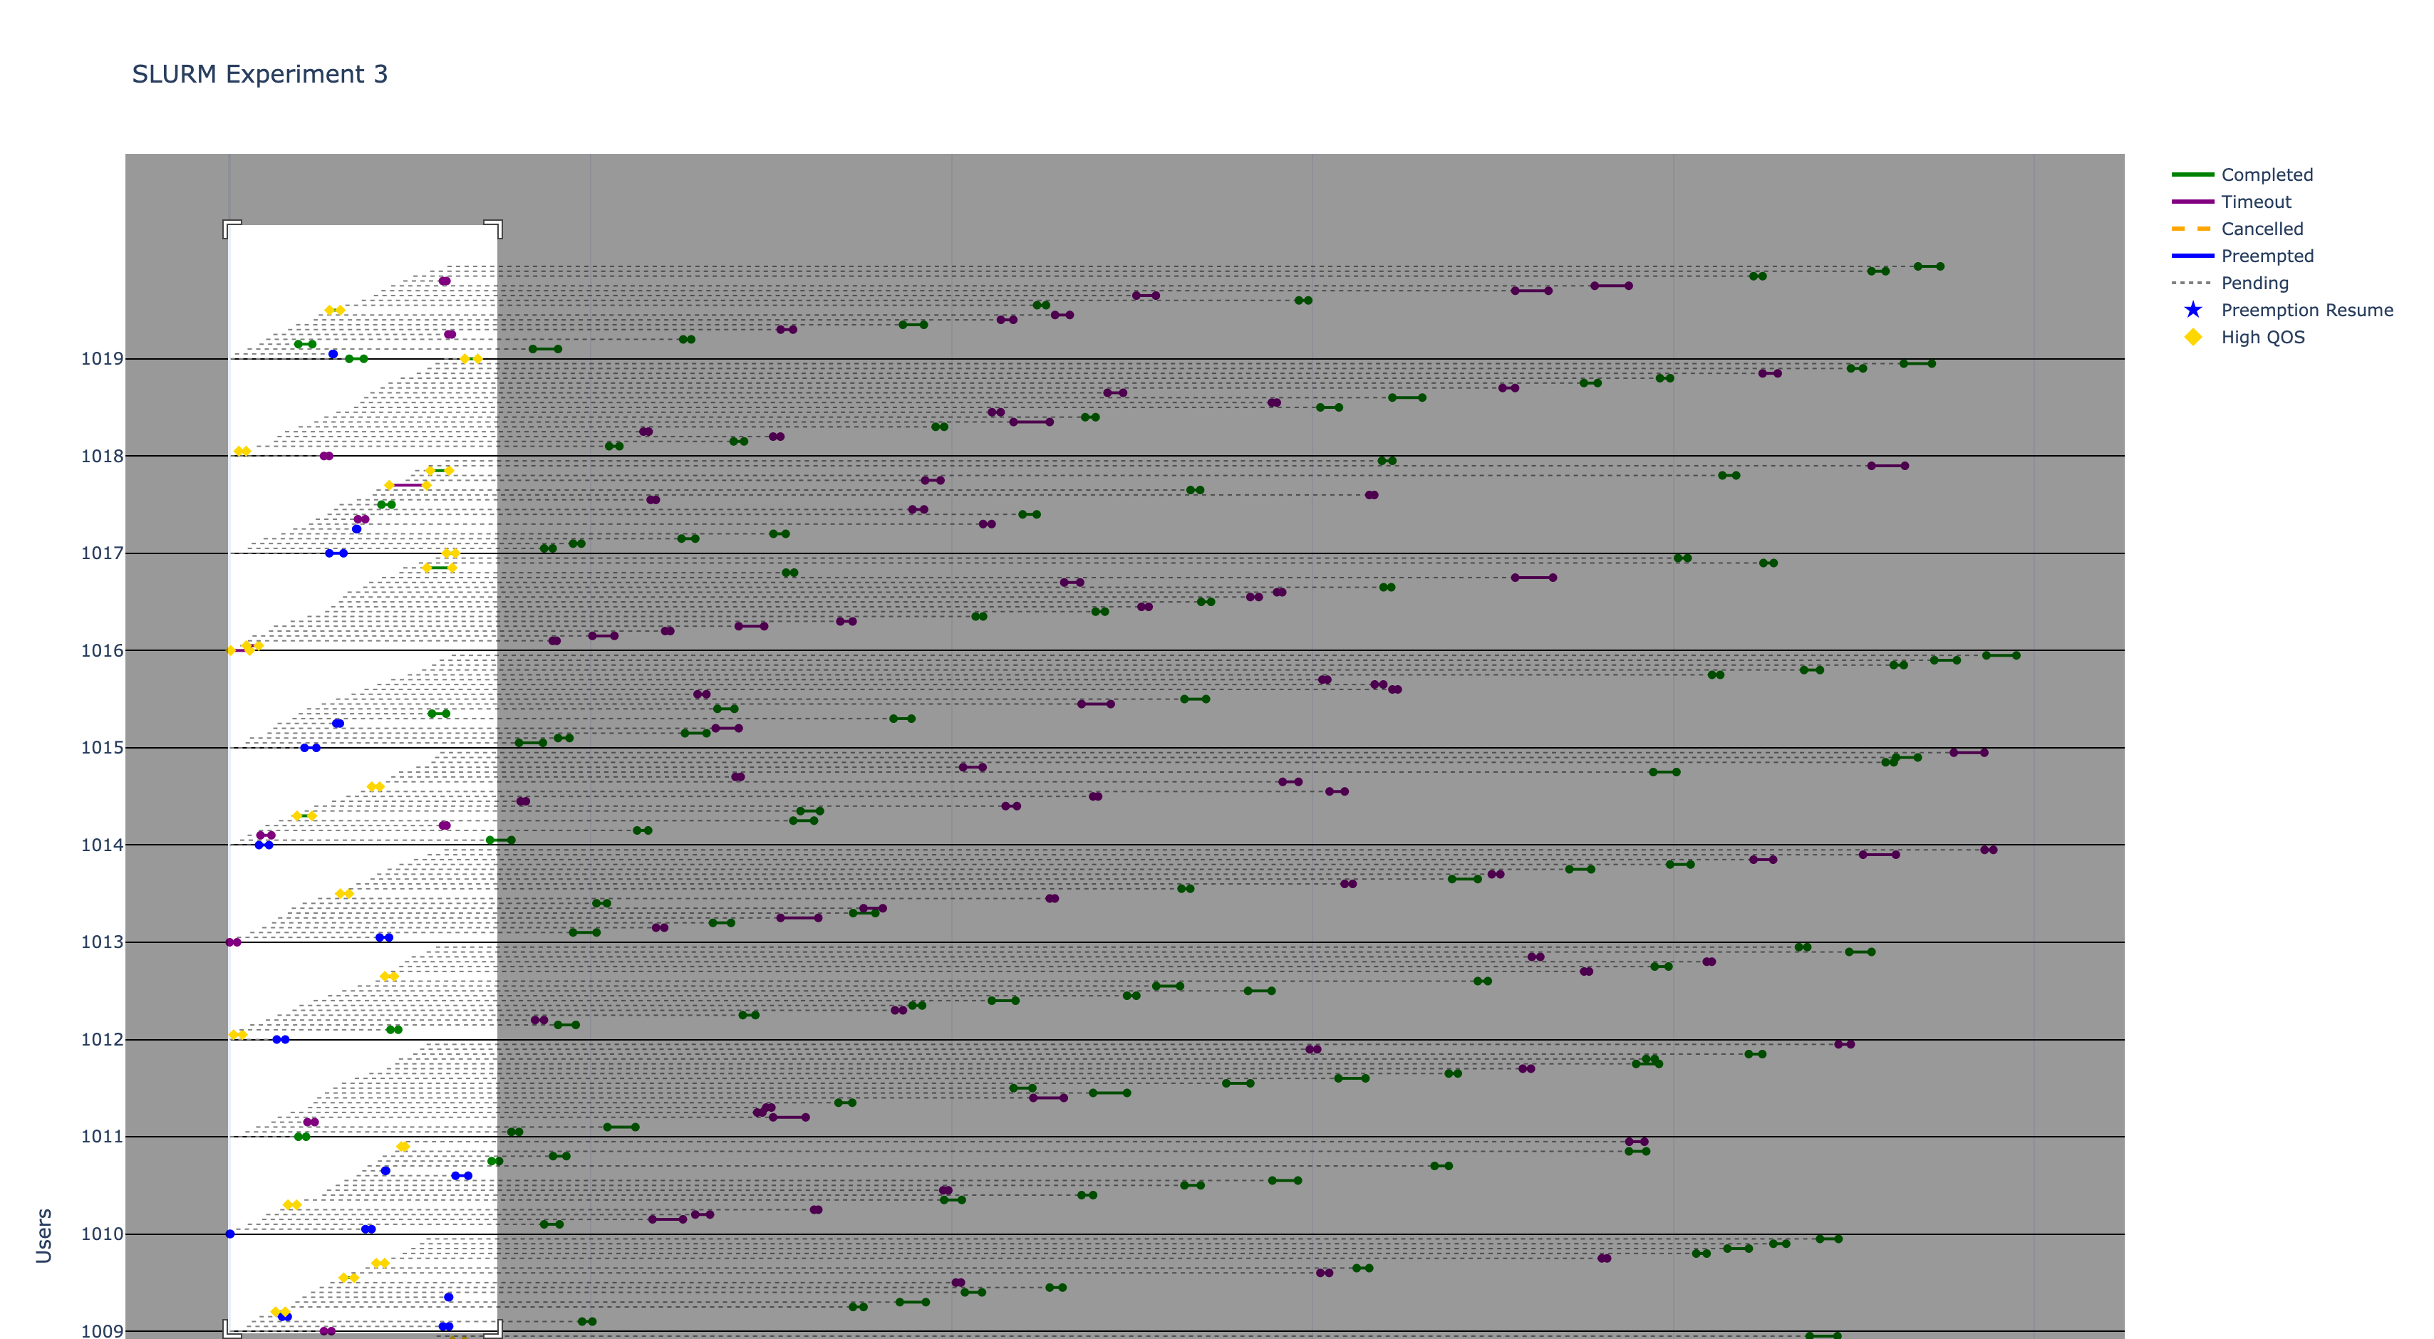
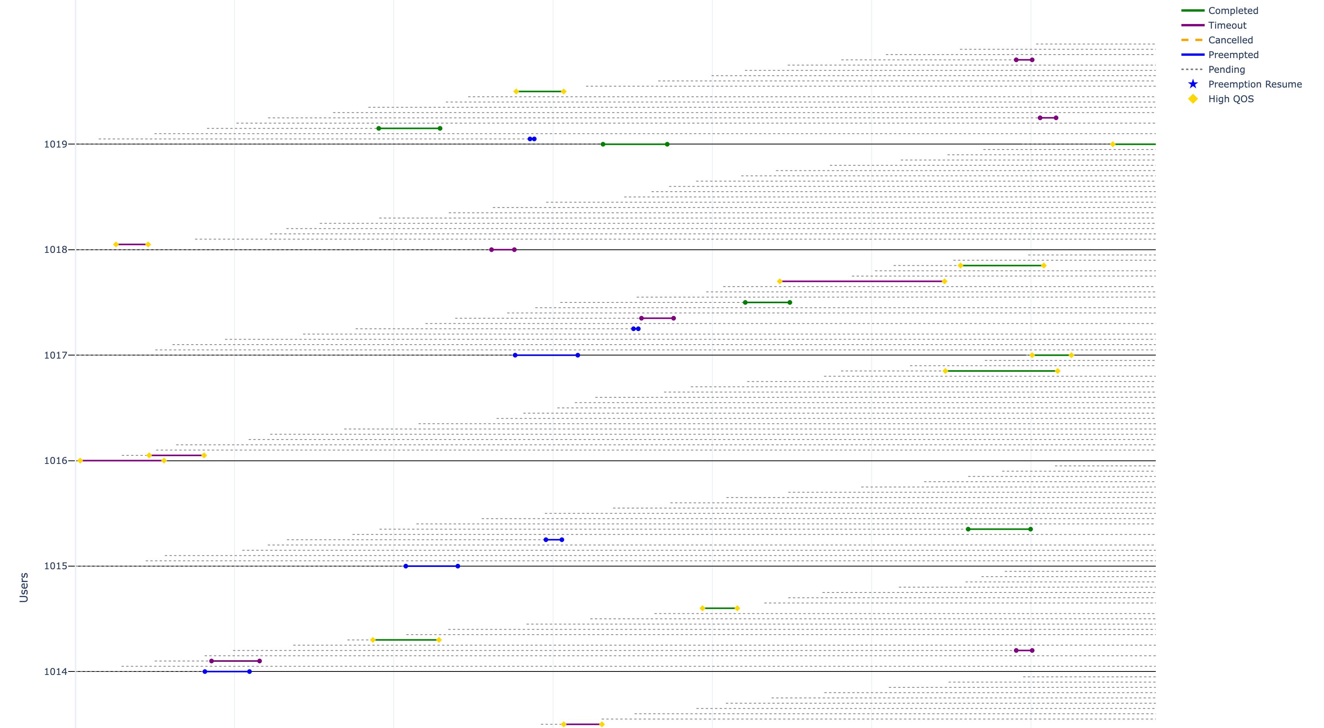
Extra Slide: Dynamic and interactive plots that may be selectively visualized by timeslice or by user(s)
Overall View, regions may be selected
for enlargement
Enlarged view

Slide 21
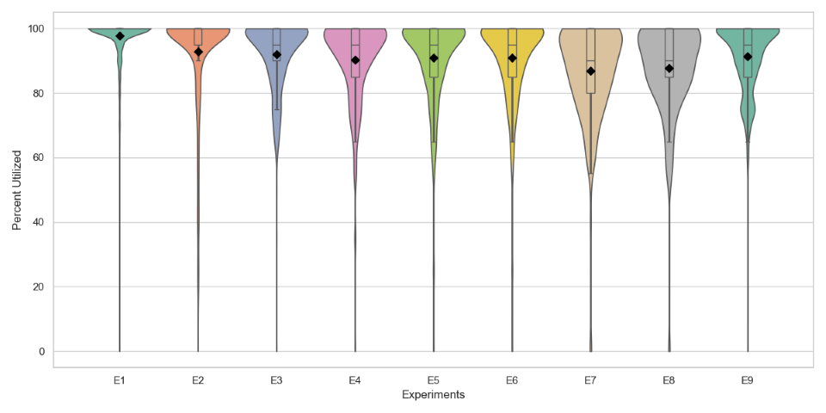
Extra Slide: Violin plot for system utilization without the extrapolation

